Slide 1
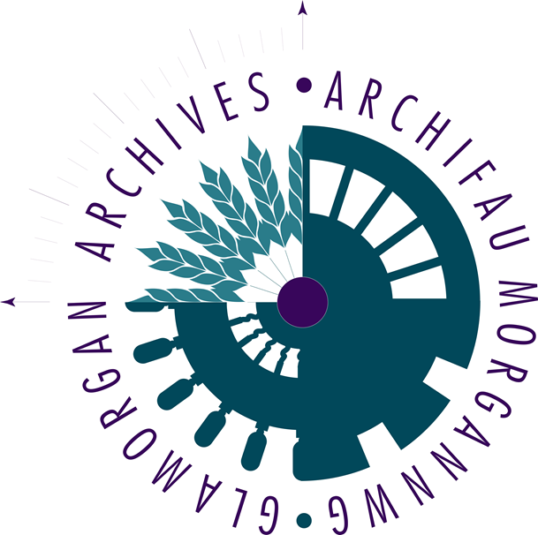
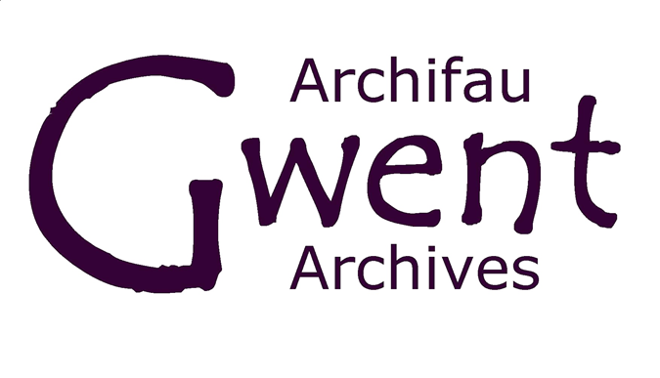
#CrowdCymru ONE-MINUTE-WONDERS

Slide 2
#CrowdCymru digital archives volunteer project
Thanks to funding from the National Lottery Heritage Fund, and National Lottery Players, this digital volunteering project was created from a working partnership between Gwent Archives, Glamorgan Archives, Cardiff University Special Collections & Archives and the National Library Wales.
The idea for the project was born from a need to demonstrate that as project partners we were endeavoring to taking a swift, proactive, and collaborative approach to modernize our services to meet the ambitious roadmap of the Welsh Government’s Digital Strategy of Wales which aims to “improve the lives of everyone through collaboration, innovation and better public services”.
We harnessed the exceptional knowledge of individuals across Wales – and beyond- to help us improve the information about our collections.
Using a newly created bi-lingual online platform developed by the National Library of Wales, we invited volunteers to tag, index and transcribe documents to make them more accessible for researchers.
This process equipped more people with the digital skills they now need to remain well-connected across their communities and to develop these skills to take full advantage in seeking opportunities in the workplace and for wellbeing. Moreover, we have paved the way for archives services to develop new models for remote volunteering without the need to travel that support the Welsh Government’s ambition to reduce our carbon footprint. Our volunteer numbers totaled ninety and although the majority came from Wales, we also had sign-ups from USA, Canada, Australia & South Korea.
Together they generously gave over 1,430 hours of time volunteering for this project.
This project ended on November 30 and throughout these 16 months we were overwhelmed by the sheer generosity of the heritage archives environment and sector. This project has been met, at every request, with offers of help and support and a true sense of working together supporting individual endeavors for the greater good of the whole sector. How wonderful to be part of such a great community.
https://www.gwentarchives.gov.uk/en/partnership-and-projects/crowdcymru/

Slide 3
At the end of the project, we asked our volunteers to tell us – in a ‘One Minute Wonder’ - about their favourite document, image or collection.
The responses were shown in a presentation at the end of project celebration, and you can see the favourites here.

Slide 4
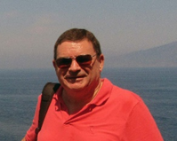
Glamorgan Archives Cardiff Dockland Community Collection
Tony Bridgend, South Wales.
Of all the images in the collection, this one stood out to me and is my favourite. Most of the other images, apart from a small number, were mainly studio-based portraits, which although interesting and wonderful in themselves, are idealised images that don’t really show life as it was. This one however, taken aboard ship gives a flavour of real life, including the deck of the ship itself, the coastline in the background, and the working clothes worn by those in the photograph. It is difficult to see what kind of vessel it is, but my guess would be a merchant vessel. This of course gave the image a greater interest to me because I have ancestors who worked aboard merchant vessels out of Cardiff Docks from the later part of the 19th Century to the early 20th Century, which incorporates the timeframe of when this photograph was taken.

Slide 5
Cardiff University Special Collections & Archives Priscilla Scott-Ellis Diaries [Diary 19 August 1938 – 14 January 1939]
Bianca, South Wales
The daughter of 8th Baron Howard de Waldon, Priscilla lived a charmed life between the family home in fashionable London society and rural Chirk Castle in north Wales. Her earlier diaries reflect the norms of her time and class. She had a huge circle of male and female friends and although she writes about “working” it wasn’t clear where this was or even when she chose to turn up
Nonetheless, she achieved an ambition to help in the Spanish Civil War. This diary is filled with descriptions of her illnesses, physical and mental; she fell in and out of love with various unsuitable men. Her Spanish female colleagues often come in for much bitching. She learnt basic nursing skills and developed a gung-ho attitude to the injured (probably understandably). She somehow continued to dine out, to visit cinemas, nightclubs and concerts. There are many pages of the diary where the text is crossed through although still clearly legible, which sometimes makes for intriguing reading.

Slide 6
Gwent Archives Newport Rugby & Athletics Club Archive
Roland Humphries, South Wales
The group photograph of Newport Rugby Internationals 1883-1921 depicts a formidable array of men, some wearing suits and ties, others in their international jerseys and caps. Among the Welshmen, three England players, one Scots and one Irish are noticeable by their kit.
Top left is Joseph Jehoidah Hodges, one of the great forwards of the era. He showed his adaptability against England in 1903 by taking the place of the injured wing and scoring three tries in a 21-5 victory for Wales.
Alongside my (distant) relative Willie Llewellyn of Tonypandy, Hodges played for the Welsh team who famously beat the touring All Blacks in 1905.
Also pictured is Major Thomas Henry (‘Tommy’) Vile, who played for the British Isles (before representing Wales), fought in two World Wars, and became President of the WRFU and High Sheriff of Monmouthshire.
A nice piece of sports history.

Slide 7
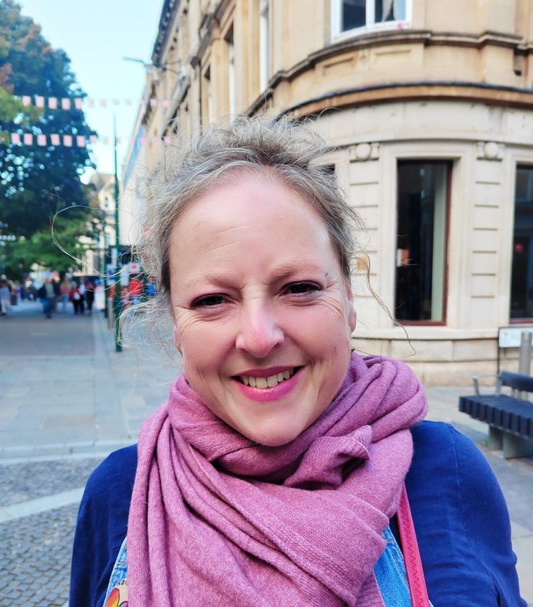
Gwent Archive Gwent Lesbian and Gay Group
Heidi, Newport, South Wales
Work and family commitments over the last year have prevented me from registering to work on the platform but I have followed the project's progress through Jen's informative emails. However, I recently looked at the platform and saw this poster from the Gwent Lesbian and Gay Group collection. So many things about this resonate with me! I live in Newport, in 1987 I was 17 and spent some great nights at Lazers, and Tootsie and Some Like It Hot both appear in my top five favorite films of all time.
I also love the home-made look of this poster and all the newsletters and art-work in this collection – you can just imagine the group sitting round a table having fun designing and creating.
I read on the Gwent Archives Facebook page that the group, established in 1986, wanted to offer an alternative to the Cardiff gay scene and organized monthly discos, newsletters, meetings, trips etc.
They also worked to disseminate information on HIV and AIDS and struggled to find venues due to prejudice about the AIDS crisis, so I would be proud to work on this collection

Slide 8
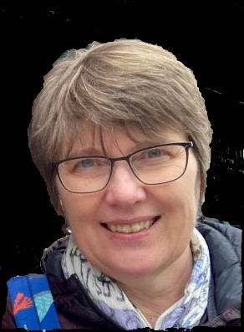
Cardiff University Special Collections & Archives Edward Thomas Literary Archive
17 Woodville Street 15.viii '98
“My dearest Friend, I can fancy how you would have enjoyed the walk I had on Friday last! I went to see a waterfall in the midst of broad woods approached by quiet fields, but the whole day was pleasant. Directly after dinner I started on a walk of eight miles to Ammanford, where Gwili is. The whole road was on a mountainside by a narrow lane, hedged by rocky & ferny mounds, & crossed once or twice every mile by a little stream. It was very hot; the last foxgloves were there, & the first blackberries; the fern smelt pleasantly. At the end the walk I had tea with Gwili his headmaster "Watkyn Wyn", a famous bard & humourist. Then afterwards we went to see the waterfalls of Glyn Hir, with their "silent sound" as Gwili says. I bought back a tiny bunch of herbs & ferns-some whinberries (bilberries or whostleberies). I was really very contented…….. “
Marion, Cardiff, South Wales
I like this passage as it captures Edward Thomas in a rare good humour. It shows his delight in the natural world, which is reflected in and informs his poetry. You can almost smell the ferns and hear the sound of the water! He clearly loved his country walks, and Helen; who was frequently at home with the children and separated from her husband; must have wished she could be there too.

Slide 9
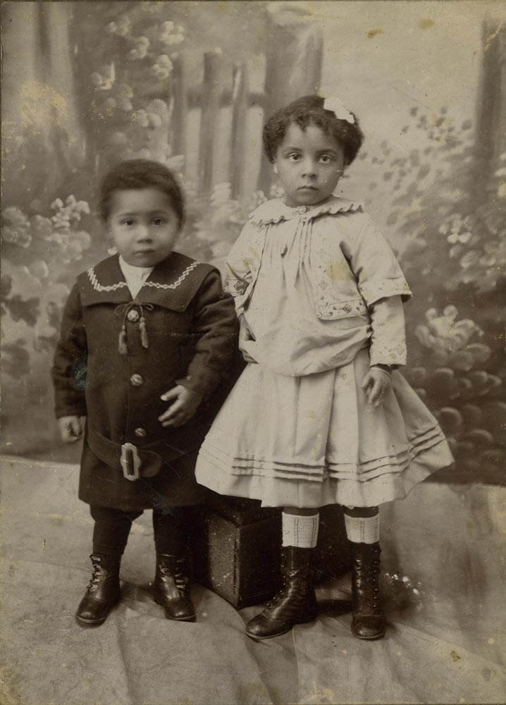
Glamorgan Archives Cardiff Docklands Community Collection
Kathryn Lewis, South Wales
This photograph was one of my favourites in a collection of delightful photographs of the Cardiff Dockland Community. It is a studio portrait photograph of two very young children taken by Fred Petersen 232 Bute Street Cardiff.
They seem to be wearing their “Sunday best” clothes and I was able to highlight the details. I particularly like the shiny boots both children are wearing which were probably polished especially for the photograph. Their clothes may well be home-made but they have lovely details such as the belt, buttons and collar on the coat of the younger child along with the edge of the skirt and jacket of the older child.
It looks as though the older child has a protective arm around the younger child, maybe they are siblings and they both have such solemn expressions rather than a smile for the camera. I hope they were rewarded for their patience.

Slide 10
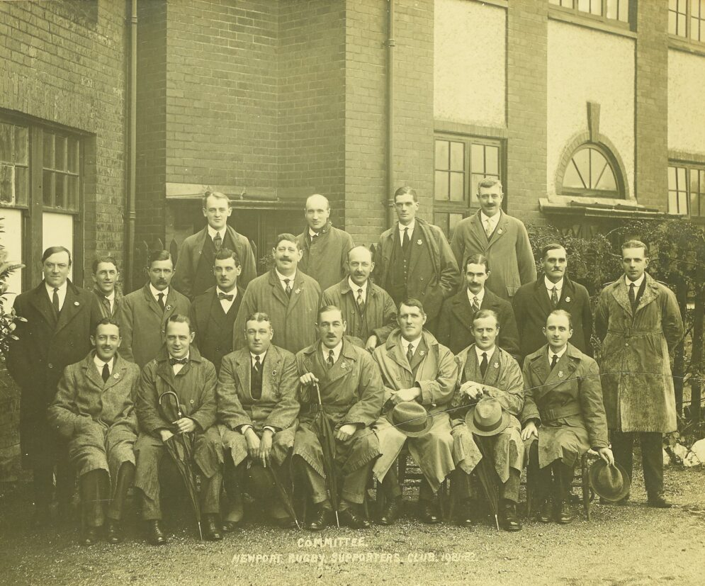
Gwent Archives Newport Rugby & Athletics Club Archive
Jen - Newport, South Wales
I find this image fascinating as most of the photographs in the Newport Rugby & Athletics Club Archive are of teams posed in their kits with trophies on display.
This one is different, showing the Newport Rugby Supporters' Club Committee. Those volunteers who organised the day-to-day running of the club.
This collection comes from Gwent Archives and as well as the photographs they hold giant ledgers containing ticket stubs, subscription forms, invoices, competition flyers and scrapbooks.
These are the men who sent out the subscription forms, stuck newspaper clippings into the scrapbooks and saved all this wonderful ephemera for us to see.
I also particularly love that if you zoom in, you can see what the weather was like that day as all the raincoats are damp and there are umbrellas on show.
This is South Wales after all!

Slide 11
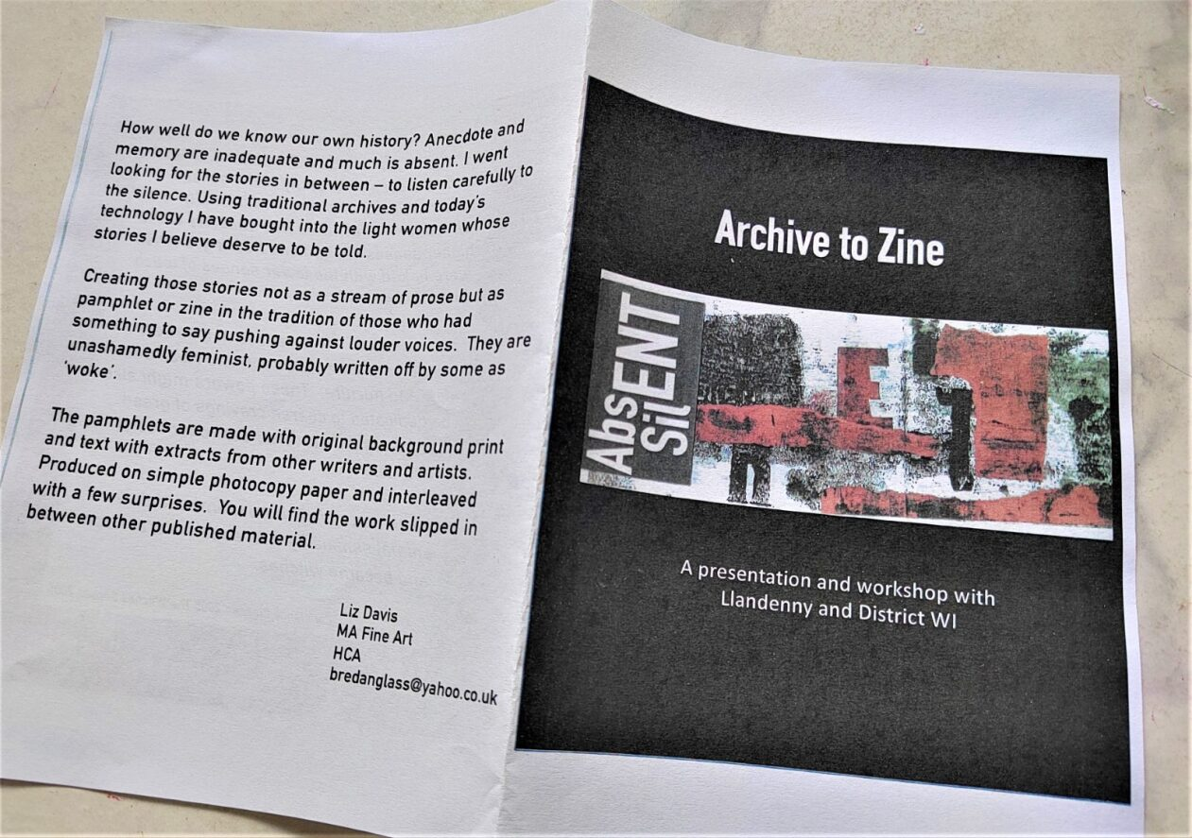
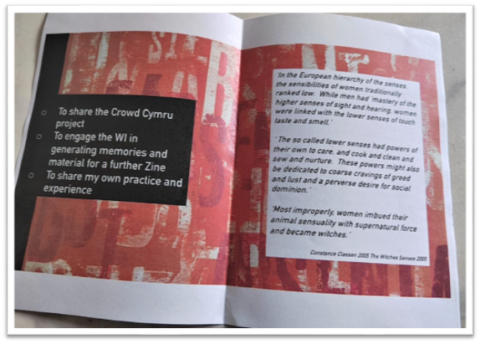
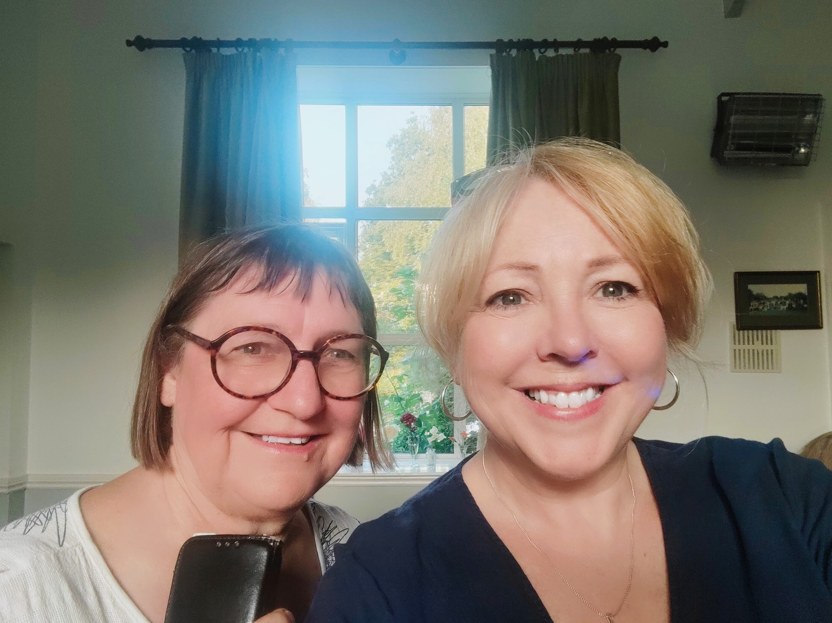
Art project inspired by the Crowd Cymru Digital Archives Project
Liz Davis was working towards an MA in Fine Art at Hereford College and volunteering with Crowd Cymru was part of her exploration of archive and memory, and the way past lives are preserved and recorded.
“My early intention had been to gain knowledge and skills in archiving, to understand better the worlds that the people of the collections we transcribe lived in and the challenges for archivists to sustain their work with diminishing resources…
I also wanted to explore my own family but to go beyond the family tree and find stories... two women emerged, my maternal and paternal grandmothers, with life stories that needed to be told…
But told how and to whom? – enter the idea of a Zine. A way of self-publishing used through the last century by fans and anarchists, feminists and others to communicate shared interests and passions.
Bringing these ideas to my art practice; the collision of archives, zines and Crowd Cymru evolved.
My first zine, issue 100 is driven by material from Crowd Cymru and looks at the lives of Edward and Helen Thomas and Priscilla Scott-Ellis.

Slide 12
#CrowdCymru
https://www.gwentarchives.gov.uk/en/partnership-and-projects/crowdcymru/

